Slide 1
Welcome! To The Antimicrobial Susceptibility Testing Subcommittee (AST SC)
January 2019

Slide 2
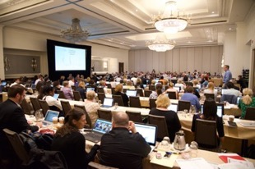
Introduction
Please review the following slides that will give you insight into CLSI and the AST SC
We will describe:
How the AST SC fits into CLSI
The various categories of CLSI volunteers
What our AST SC does
When our AST SC meets
How CLSI AST documents are developed
We look forward to your participation on the AST SC!

Slide 3
Who is CLSI?
Clinical and Laboratory Standards Institute (CLSI) is a not-for-profit membership organization that brings together the global laboratory community for a common cause: fostering excellence in laboratory medicine.
CLSI documents cover all areas of the clinical laboratory.

Slide 4
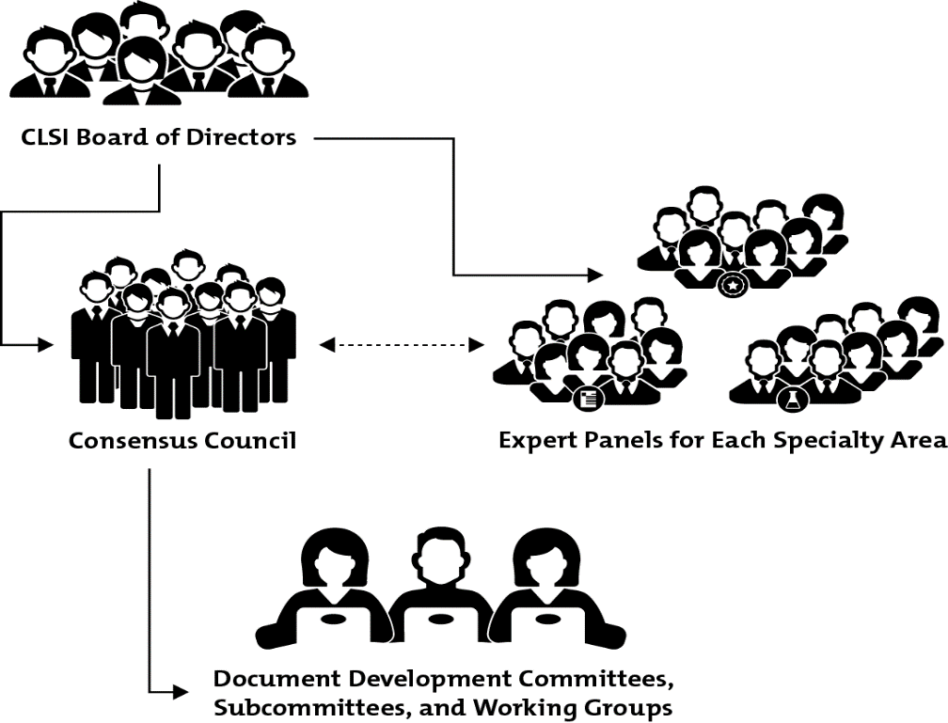
CLSI Governance Structure
Eg, Microbiology Expert Panel
AST Subcommittee fits here!

Slide 5
History of CLSI (Formerly NCCLS)
1968 – the National Committee on Clinical Laboratory Standards (NCCLS) was founded when 31 clinicians and laboratory scientists from 15 organizations met to discuss ways to "improve what [laboratories] are doing for patients" and to develop a formal consensus process for standardization.
1977 - NCCLS was accredited by the American National Standards Institute (ANSI) as a voluntary consensus standards organization.
Late 1970s - NCCLS became the home of the National Reference System for the Clinical Laboratory (NRSCL), a collection of reference systems intended to improve the comparability of laboratory test results.
2005 - the name NCCLS was changed to Clinical and Laboratory Standards Institute (CLSI) to encompass and embrace the international focus of this organization.
CLSI has evolved into a global association of 1,400+ member organizations and 400+ individual members, as well as 2,000+ volunteers.
Currently manages over 200 documents!

Slide 6
CLSI Process
Documents are vetted through the consensus process involving the three constituencies of Professions, Industry, and Government.
Meeting minutes and select additional materials are available to the public on the CLSI website.
Comments (both in-person at the meeting and in-writing) from users of documents are actively encouraged and addressed.
Ultimate products = standards documents and other materials/programs (eg, webinars, workshops, companion products) to support the standards.
Balance
Meetings are open to everyone!

Slide 7
Consensus Standards and Guidelines
Some CLSI documents are guidelines, while others qualify as standards.
Standard = identifies essential requirements for materials, methods, or practices for voluntary use in an unmodified form.
Guideline = identifies requirements for materials, methods or practices, for voluntary but recommended use.

Slide 8
CLSI Members and Volunteers
Diverse representation (worldwide) from all three constituencies. Interests between constituencies are balanced.
Industry | Government | Professions
IVD Manufacturers | Public Health Agencies | Clinical Laboratories
Pharmaceutical Manufacturers | Regulatory Bodies | Research Laboratories
LIS / HIS Vendors | Accrediting Organizations | Healthcare Delivery Systems
Suppliers |  | Educational Institutions
Clinical Research Organizations |  | Professional Societies, Trade Organizations
 |  | Standards Organizations
Abbreviations: IVD, In Vitro Diagnostic; LIS, laboratory information system; HIS, hospital information system.

Slide 9
Microbiology Subcommittees with Antimicrobial Agent Focus
Antimicrobial Susceptibility Testing Subcommittee (AST SC)
Bacteria (excluding mycobacteria)
Separate Subcommittees:
Subcommittee on Antifungal Susceptibility Tests
Veterinary Antimicrobial Susceptibility Testing (VAST)
Other antimicrobial subcommittees are formed as needed (eg, mycobacteria)

Slide 10
Introduction of Timeline of Major CLSI AST SC Documents
1975
1980
1985
1990
1995
2000
2005
2010
2015
1970
M11
MIC Method Anaerobe
NCCLS (CLSI) formed (1968)
M02
Disk Diffusion Method
M07
MIC Method Aerobe
M45
BPs Fastidious Bacteria
M23
Guidance on BPs / QC
M39 Antibiograms
M52 Verification ID & AST Systems
BPs, breakpoints; QC, quality control

Slide 11
AST SC Mission
The mission of the AST SC is to:
Develop standard reference methods for antimicrobial susceptibility tests.
Provide quality control parameters for standard test methods.
Establish breakpoints for the results of standard antimicrobial susceptibility tests and provide epidemiological cutoff values when breakpoints are not available.
Provide suggestions for testing and reporting strategies that are clinically relevant and cost-effective.
Continually refine standards and optimize detection of emerging resistance mechanisms through development of new or revised methods, breakpoints, and quality control parameters.
Educate users through multimedia communication of standards and guidelines.
Foster a dialogue with users of these methods and those who apply them.
This mission statement is listed in the front of each AST document!

Slide 12
Volunteer Responsibilities: AST SC
Chairholder – Melvin Weinstein, MD
Ensures that committee objectives are met and reports to the Consensus Council (CC) Chairholder
Appoints Members and Advisors
Plans, monitors, and schedules the document revision process
Moderates the discussions at face-to-face meetings
Does not vote (except in select situations)
Vice-Chairholder – James Lewis, II, PharmD, FIDSA
Serves as leader in chairholder’s absence
Learns process in preparation for role as chairholder and when rotating from the role of chairholder, assists the new chairholder in the transition
Does not vote

Slide 13
Volunteer Responsibilities: AST SC (Cont.)
Members - appointed
Must include representatives from each of the three constituencies
Serve as authors and subject matter experts
Serve on working groups (WGs)
Vote on technical decisions and draft documents
Advisors - appointed
Provide technical expertise to the SC
Serve on WGs
Provide input on draft documents submitted for approval
Appointed Members and Advisors serve one-year terms that are renewable yearly for up to 4 years.

Slide 14
Volunteer Responsibilities: AST SC (Cont.)
Reviewers
May serve on WGs and/or provide technical input
Review and comment on draft documents
Anyone with an interest in the AST SC’s goals can become a reviewer make suggestions, submit data and join WGs. (Simply submit a request to CLSI.)
Guests
Are not on the official roster
Have not submitted disclosure of interests and curriculum vitae (CV)
Can make suggestions but cannot serve on a WG
To become a Member, Advisor, or Reviewer and be put on the official roster, you must submit disclosure of interests and CV. In addition, you need to pay an administrative fee (this fee is usually covered through one’s organizational CLSI membership).

Slide 15
CLSI AST SC Volunteer Opportunities
Function | Member | Advisor | Reviewer | Guest
Appointed by SC chair | X | X | X
Serve on WG | X | X | X
Contribute - raise issues | X | X | X | X
Contribute - technical expertise | X | X | X
Contribute - provide data | X | X | X | X
Review / comment on draft documents | X | X | X | X
Vote (preliminary in WG meeting)* | X | X | X
Vote (final at plenary session) | X
* If officially appointed AST SC or WG member

Slide 16
Documents Managed by CLSI AST SC
No. | Document | Revision Cycle
M02 | Disk diffusion method (aerobes) | 3–5 years
M07 | MIC testing methods (aerobes) | 3–5 years
M11 | MIC testing methods (anaerobes) | 3–5 years
M100 | Tables (disk and MIC for aerobes and MIC for anaerobes) | Annual
M23* | Guidance for setting breakpoints, setting QC ranges, making recommendations in AST documents | 5 years (or as needed)
M39* | Antibiograms | 5 years (or as needed)
M45* | Fastidious organism tables | 5 years (or as needed)
* Guidelines

Slide 17
“Standing” Working Groups of AST SC
Working Group (WG)* | Primary Function
Methods Development and Standardization WG | Develops or modifies test methods
Methods Application and Interpretation WG | Determines how a test method can be used
Quality Control WG | Sets QC ranges
Text and Tables WG | Incorporates approved recommendations from other WGs into M100
Breakpoint WG | Sets clinical breakpoints and epidemiological cutoff values (ECVs)
Outreach WG | Provides educational and informational outreach to stakeholders
All WGs review data and make recommendations consistent with their primary function.
* This slide excludes the ad hoc WGs.

Slide 18
AST SC WGs: 2019
AST Subcommittee Chairholder and Vice-chairholder
6 Standing WG and their Ad Hoc WGs
WG under AST but not assigned to any of the Standing WGs
M23 (revision)
Methods Development & Standardization
Coagulase Negative Staph (CoNS)
Colistin AST
Methods Application & Interpretation
Anaerobe
mCIM
Coordinated Development Drugs-Devices
Direct Blood Culture Susceptibility
CLSI vs EUCAST Media
Intrinsic Resistance
QC
Text & Tables
M02/M07 Revision
Breakpoint
Cefiderocol
Cefotetan/Cefoxitin-Enterobacteriaceae
Ceftaroline
Ceftazidime-avibactam
Daptomycin
Meropenem-vaborbactam
ECVs
Shigella/Fluoroquinolones
Outreach
M39 Antibiograms
(revision)
Neisseria gonorrhoeae
An Ad hoc WG is under one of the 6 Standing WGs. Ad hoc WG usually has an assignment that is limited in scope and is disbanded upon completion of the assignment.

Slide 19
CLSI AST SC Meeting Schedule
January | “Face to Face” Meeting*
January–May | Background Studies and More
May | Submit Agenda Materials
June | “Face to Face” Meeting*
June–December | Background Studies and More
December | Submit Agenda Materials
The AST SC meets twice a year. Decisions are made at these meetings.
Much of the work is done by Standing WGs and Ad Hoc WGs between the meetings.
* Receive agenda materials approximately 4–6 weeks before the meeting.
You must be an AST SC or WG member or register for the meeting to receive the agenda materials.

Slide 20
Typical AST SC On-Site Meeting Schedule
Day | Session | Comment
Saturday
5:00–7:00 PM | Education Workshop | Free and open to all; Continuing education credits available! Covers topics related to AST SC, antifungal SC, veterinary SC, etc.
Sunday
8:00 AM–5:00 PM | Working Groups | Open to all Some concurrent (pick & choose) Solicit comments from all “Preliminary” vote on issues
5:30–7:00 PM | Executive session | Voting members and by invitation only
6:30–7:00 PM | New Member Reception | Open to all new registered attendees
7:00–8:30 PM | Reception | Open to all registered attendees
Monday
8:00 AM–Noon | Working Groups (cont’d) | As needed (if no WG meetings needed, plenary starts at 8 am)
1:00–5:00 PM | Plenary Session | Open to all Solicit comments from all Final vote on issues
Tuesday
8:00 AM–Noon | Plenary Session (cont’d)

Slide 21
Taking an Issue to Approval!
Ad hoc
Working Group
Standing Working Group
AST SC
Detailed discussion among those who participated in the task
Detailed summary of Ad hoc WGs efforts; preliminary vote
Summary and final vote at plenary session

Slide 22
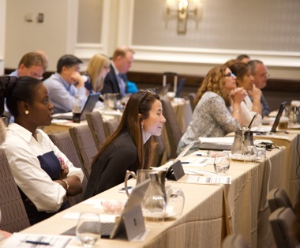
How can YOU become a WG member?
Make sure you are a “Reviewer” (see slide 14 for more information) and determine your interest in a particular WG.
Speak with the AST SC Chairholder, WG Chairholder, and/or Outreach WG member for placement in appropriate WG.
Plan to attend a WG session.
Feel free to make suggestions, provide data, offer to work on projects, etc.

Slide 23
Must YOU be a WG member to attend a WG meeting, raise issues, or contribute data?
No!
Anyone can raise issues/contribute data to the agenda book that is “new” or that is currently being discussed.
Meet with WG chair (in-person at a face-to-face meeting or remotely)
Material must be in the agenda book to be discussed.
Deadline for submission of agenda book material is approximately 6 weeks before the January or June meetings.

Slide 24
To register for the meeting visit clsi.org/committeesweeks.
For questions, contact CLSI AST SC coordinator, Marcy Hackenbrack (mhackenbrack@clsi.org).
Review agenda materials that are emailed to you 4-6 weeks prior to the meeting.
Decide which WGs to attend.
(Some issues are ongoing; check previous meeting materials on the CLSI website to review what has been discussed at an earlier meeting.)
Review CLSI M23 which describes how breakpoints and QC ranges are established.
Talk with a colleague who has been volunteering with CLSI on the AST SC.
Attend the free, Education Workshop on Saturday evening.
Attend Sunday and Monday WGs (feel free to “roam” from one to another).
Attend Monday and Tuesday plenary sessions.
Steps to ensure YOU will have a rewarding experience at YOUR first CLSI AST SC meeting!

Slide 25
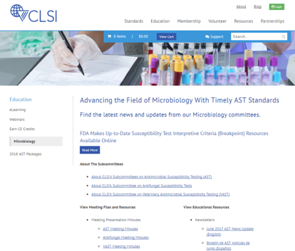
How can you learn more about CLSI AST SC and ongoing AST SC projects?
clsi.org/micro
Here you will find:
Minutes / Materials from previous meetings
Current and past AST SC Newsletters
PowerPoints from Workshop presentations
Dates of upcoming meetings
…and much more!

Slide 26
Benefits of becoming a CLSI AST SC volunteer
Learn about the latest developments in AST
Learn about new antimicrobial agents and new resistance mechanisms
Network with leaders in the AST field (microbiologists, pharmacists, clinicians, public health workers, etc.)
Grow your resume with your involvement on the AST SC
Obtain P.A.C.E. CE credits for free during the Education Workshop
Have fun!

Slide 27
Thank you for your interest, dedication, and commitment!

