Slide 1
The Mathematical and Scientific Basis for Developing and Setting Epidemiological Cut-offs (ECOFFs)
John Turnidge
January, 2018

Slide 2
Topics: Questions I will try to answer
What is an MIC, mathematically speaking?
Why the 2-fold dilution series?
How are wild-type MICs distributed?
Why are wild-type MICs distributed that way?
What is the intended objective of ECOFFs?
What method should we use for ECOFF estimation?

Slide 3
Topics: Answers in brief…
What is an MIC, mathematically speaking?
  an interval measure
Why the 2-fold dilution series?
  a happy accident of history
How are wild-type MICs distributed?
  anything but wildly
Why are wild-type MICs distributed that way?
  because of variations

Slide 4
Topics: Answers in brief…
What is the intended objective of ECOFFs?
  intention will influence the choice of ECOFF
What method should we use for ECOFF estimation?
  several to choose from…

Slide 5
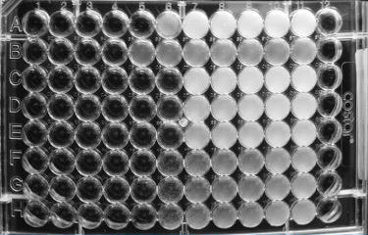
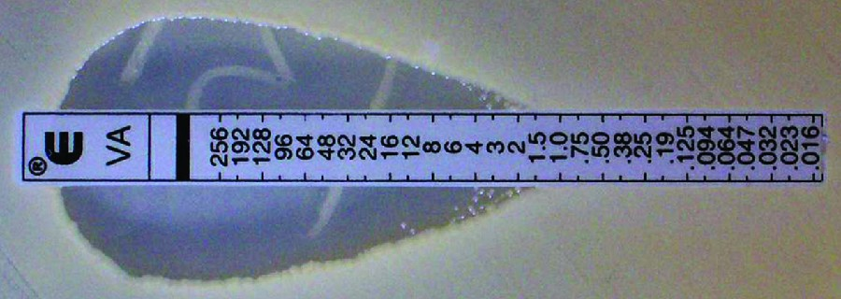
What is an MIC, mathematically speaking?
MICs are mostly measured on the two-fold dilution scale
The two-fold dilution scale is an interval scale
It is a scale of ‘convenience’, allowing us to rapidly quantify the phenotype,
but any other scale is possible, e.g.
  the scale on the Etest® strip
  or the ‘half-step’ scale:
  ...0.5, 0.7 , 1 , 1.4 , 2 , 2.8…

Slide 6
What is an MIC, mathematically speaking?
~0.25 – 0.45
It is possible to measure MICs on even finer scales, but…
  it isn’t practical for large numbers of tests
  the benefits are not obvious (they are there!)
  it increases the risk of ‘skip’ wells
  there is a limit, which is bug-drug dependent
    e.g. Soothill et al., JAC 1992; 29: 137-139;
    colonies formed from an individual CFU in an inoculum have a range of MICs
Agar dilution, P. aeruginosa, gentamicin, arithmetic scale
of dilutions, ~20 CFU per drop.

Slide 7
What is an MIC?
Less obviously, the MIC values that we normally assign are actually
at the upper end of the interval
  that’s because, for instance, a strain that grows up to a concentration of
  1.5 mg/L, but not higher, will grow at 1 mg/L but not at 2 mg/L, and it’s MIC will be recorded as 2 mg/L (not as 1.6 mg/L say) in our two-fold dilution series

Slide 8
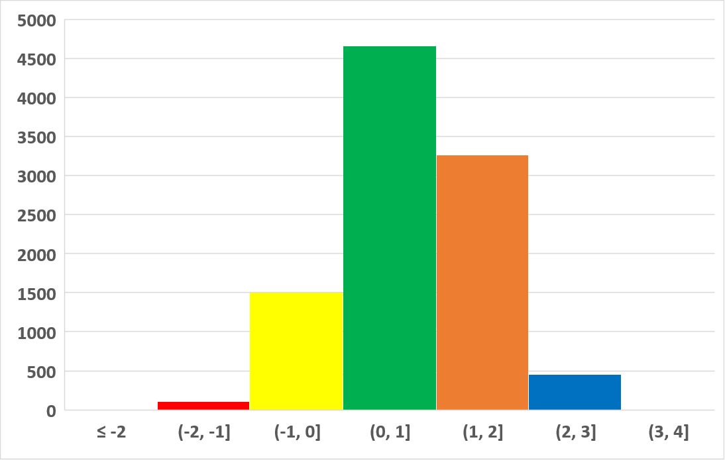
What is an MIC?
The way the data are usually presented…
| | | | | | |
≤ 0.25 0.5 1 2 4 8 ≥16

Slide 9
What is an MIC?
The correct way to present the data…
| | | | | | |
≤ 0.25 0.5 1 2 4 8 ≥16

Slide 10
What is an MIC?
Or mathematically, as a formal histogram on a log₂ scale…
“(“ means down to but not including
“]” means up to and including
Interval labels

Slide 11
Why the two-fold dilution scale?
The two-fold scale is a logarithmic scale
Which seems to have started with Alexander Fleming in 1929…

Slide 12
How are wild-type MICs distributed?
As it turns out, a logarithmic scale is the right thing to use…
  it follows from the law of mass action as it applies to drug-receptor interactions, which is what is being measured indirectly*
MICs are distributed on a Log-Normal scale
  or as near to Log-Normal as can be
  estimated on the (rather coarse)
  two-fold dilution interval scale
  note that the Log-Normal scale has no lower
  or upper bound, i.e. doesn’t come with an
  ‘in-built’ ECOFF
* Riggs DS, 1963. The Mathematical Approach to Physiological Problems. The MIT Press, Cambridge, MA. pp 286-296

Slide 13
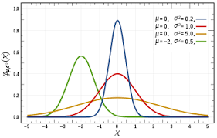
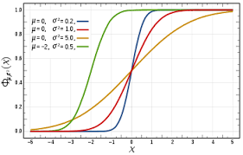
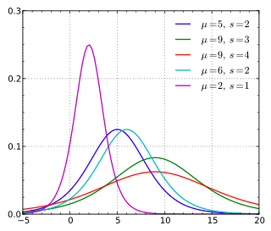
How are wild-type MICs distributed?
There are many other “bell curve” shaped symmetrical distributions other than the Normal = Gaussian, especially the Logistic (related to the Hill equation that we use for PK-PD exposure-response curves)
The two-dilution scale that we use is surprisingly rather coarse and therefore it is not possible to show which “bell curve” is the best fit
Normal distribution
Cumulative normal distribution
Logistic distribution
*Wadsworth. Handbook of Statistical Methods for Engineers and Scientists, 2nd Ed..1998. p 6.6

Slide 14
How are wild-type MICs distributed?
In most circumstances, the Normal distribution is preferred, as it is a consequence of the central limit theorem, which deals with distributions that are the sum of multiple sources of variation*
The cumulative Normal distribution
is especially valuable for the analysis
of MIC distribution data because
it automatically models results
when the values which are at the
upper end of the interval scale
Cumulative normal distribution

Slide 15
Why are wild-type MICs distributed that way?
Variations!
  Assay variation
    reagents
    intra-laboratory (reading)
    inter-laboratory (conditions)
  Biological variation
    strain-to-strain
Biological variation contributed between 10.4% and 98.8% of the variances for different bug-drug combinations
We have some information on this now for disk diffusion, but not much for broth microdilution

Slide 16
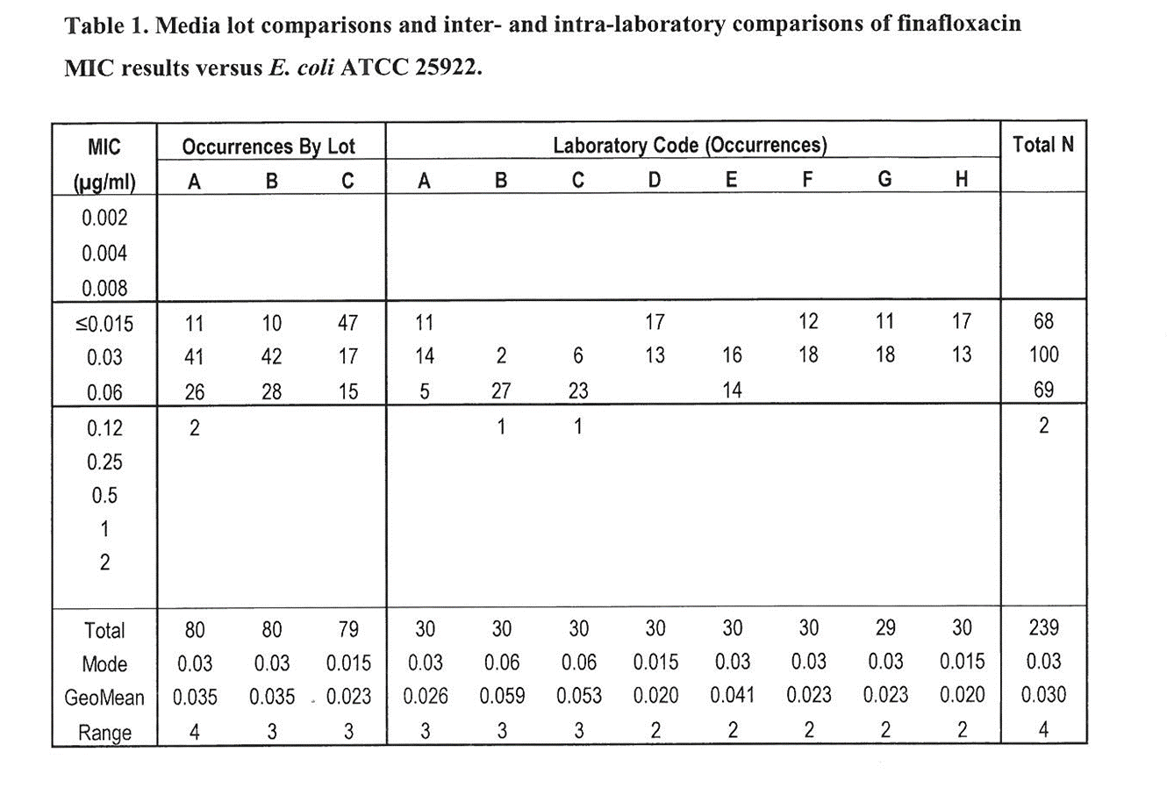
Why are wild-type MICs distributed that way?
Same strain, same batches of reagents
Variations!
  Assay variation
    reagents
    intra-laboratory (reading)
    inter-laboratory (conditions)
  Biological variation
    strain-to-strain

Slide 17
What is the intended objective of ECOFFs?
To separate wild type from non-wild type?
  only when there is little or no overlap with non-wild type
To ensure resistance mechanisms are detected?
  requires a knowledge of all resistance mechanisms
To ensure the ‘upper end’ of the wild type is captured?
  overlap would have to accepted
To align with molecular resistance detection?
  ECOFFs are about the phenotypic expression
Gunnar will address this

Slide 18
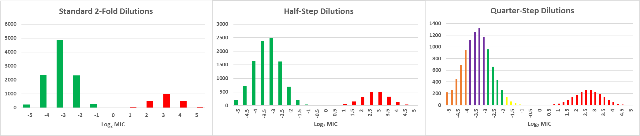
How well does the ECOFF separate wild type from the non-wild type?
Variations in wild type versus non-wild type
ECOFF
Log₂ Mean Wild-Type MIC = –3.5 Log₂ Mean Non-Wild Type MIC = 2.5
Log₂ SD Wild-Type MIC = 0.75 Log₂ SD Non-Wild Type MIC = 0.75

Slide 19
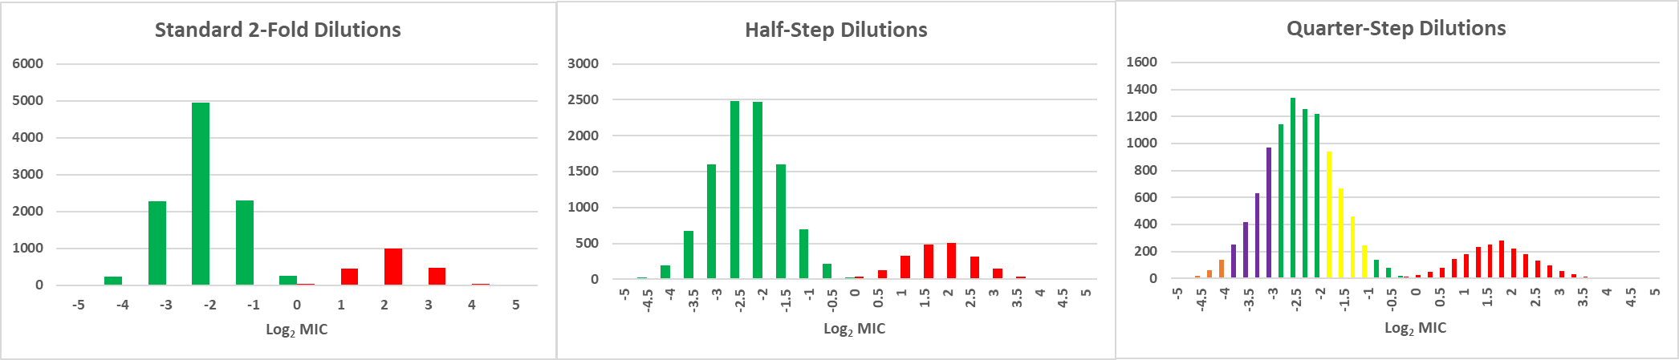
How well does the ECOFF separate wild type from the non-wild type?
Variations in wild type versus non-wild type
ECOFF
Log₂ Mean Wild-Type MIC = –2.5 Log₂ Mean Non-Wild Type MIC = 1.5

Slide 20
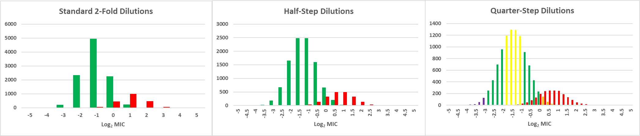
How well does the ECOFF separate wild type from the non-wild type?
Variations in wild type versus non-wild type
ECOFF?
Log₂ Mean Wild-Type MIC = –1.5 Log₂ Mean Non-Wild Type MIC = 0.5

Slide 21
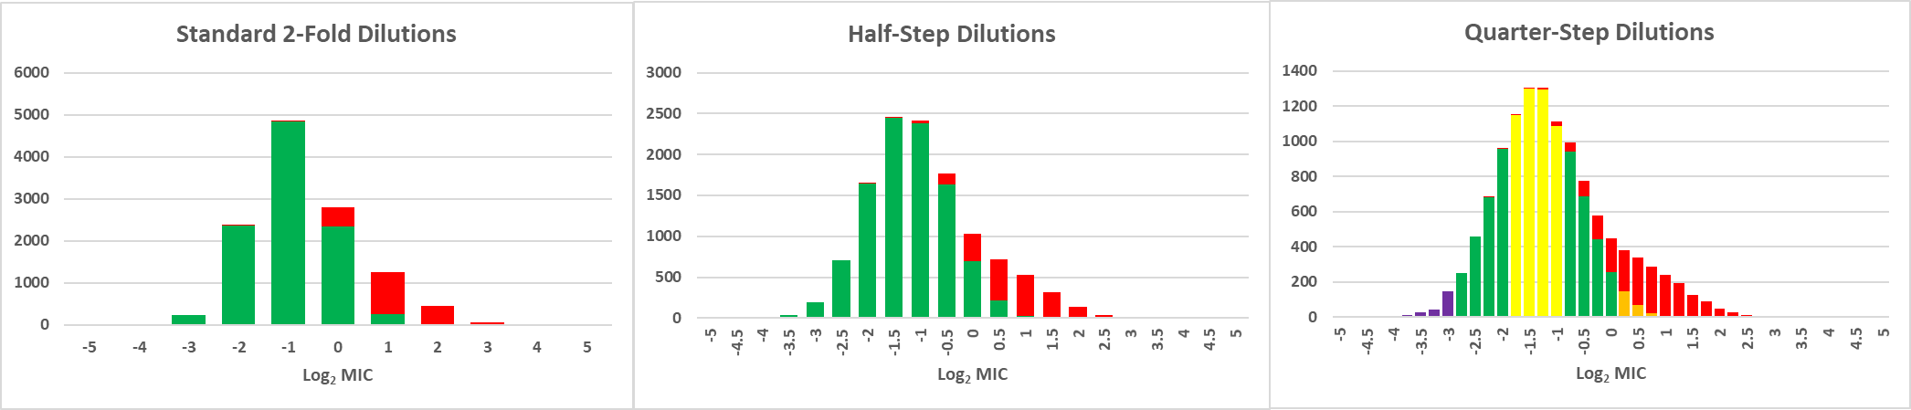
How well does the ECOFF separate wild type from the non-wild type?
Variations in wild type versus non-wild type
ECOFF?
Skewed
Log₂ Mean Wild-Type MIC = –1.5 Log₂ Mean Non-Wild Type MIC = 0.5

Slide 22
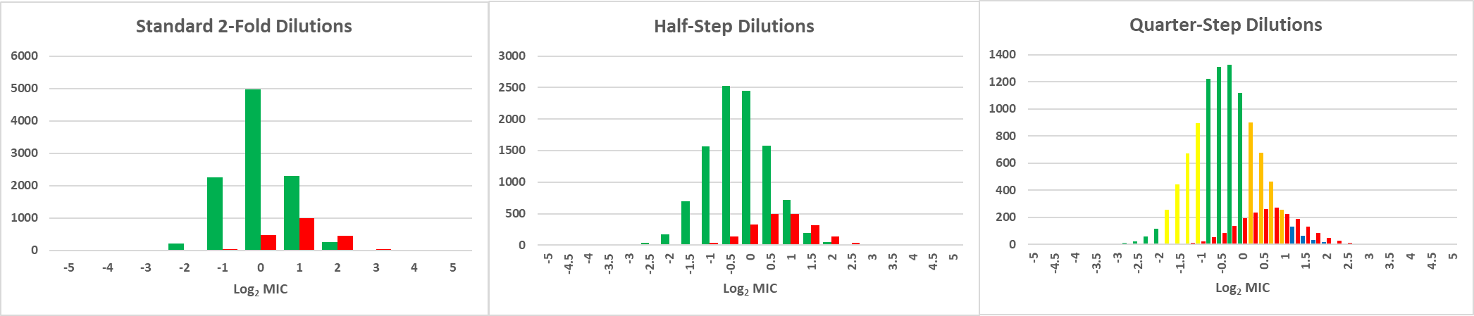
How well does the ECOFF separate wild type from the non-wild type?
Variations in wild type versus non-wild type
ECOFF?
Log₂ Mean Wild-Type MIC = –0.5 Log₂ Mean Non-Wild Type MIC = 0.5

Slide 23
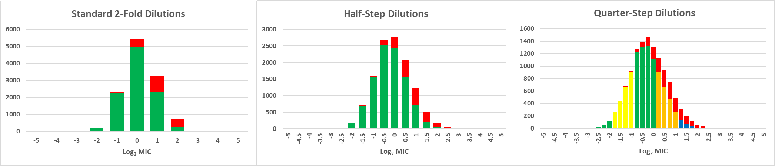
How well does the ECOFF separate wild type from the non-wild type?
Variations in wild type versus non-wild type
ECOFF?
Skew is
difficult to see
Log₂ Mean Wild-Type MIC = –0.5 Log₂ Mean Non-Wild Type MIC = 0.5

Slide 24
What method should we use for ECOFF estimation?
The visual estimation (“eyeball”) method
  Kahlmeter
The 95% rule
  Pfaller et al., J Clin Microbiol 2009
The Normalised Resistance Interpretation
  Kronvall, J Clin Microbiol 2010
The iterative statistical method
  Turnidge, Kronvall, Kahlmeter, Clin Microbiol Infect 2006
Multimodal analysis
  Meletiadis et al., Antimicrob Agents Chemother 2012
Multinomial method
  Jaspers et al., Stats in Med 2014
The second derivative method
  Meletiadis et al, Antimicrob Agents Chemother 2017
If there are many methods,
it’s likely that none are perfect!

Slide 25
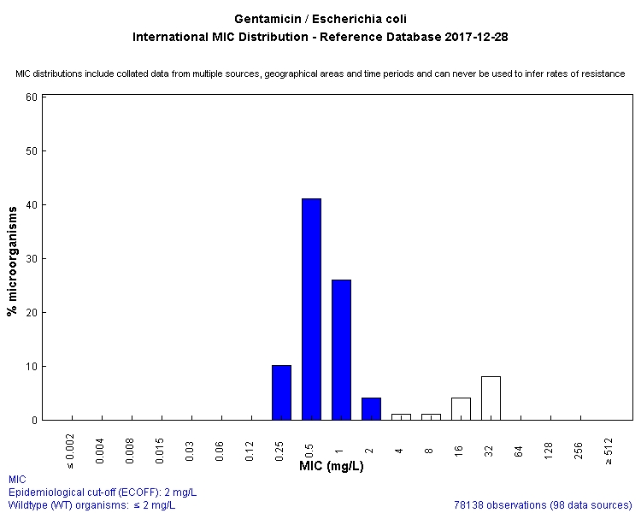
Visual estimation method
As currently displayed for almost all distributions on the EUCAST MIC website
Visual estimation of symmetry and proportions
e.g. E. coli - gentamicin https://mic.eucast.org/Eucast2/regShow.jsp?Id=908

Slide 26
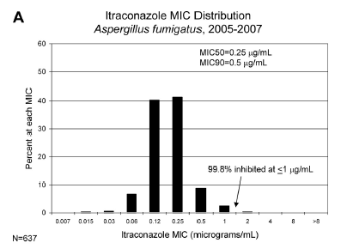
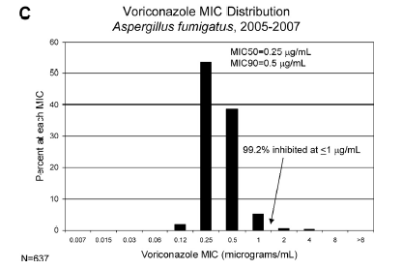
The 95% Rule
Pfaller et al., J Clin Microbiol 2009

Slide 27
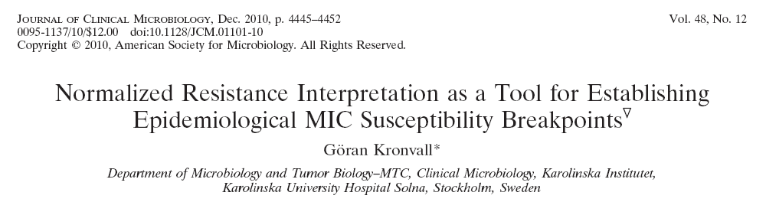
Normalized Resistance Interpretation
Uses an adaptation of a method originally devised for “ECOFFs” for zone diameter distributions
  Kronvall et al., Clin Micro Infect 2003; 9:120-132

Slide 28
Normalized Resistance Interpretation
Implemented in Automatic NRI calculations for MIC distributions, Excel beta-version http://www.bioscand.se/nri/
Original distribution
Kronvall, J Clin Microbiol 2010; 48:4445-4452

Slide 29
Normalized Resistance Interpretation
Implemented in Automatic NRI calculations for MIC distributions, Excel beta-version http://www.bioscand.se/nri/
Line of best fit
Mean and SD calculated from line of best fit
ECOFF = Mean* + 2 x SD then rounded up
(*Mean adjusted down in an unspecified manner)
Dummy values
Kronvall, J Clin Microbiol 2010; 48:4445-4452

Slide 30
Normalized Resistance Interpretation
Implemented in Automatic NRI calculations for MIC distributions, Excel beta-version http://www.bioscand.se/nri/
Example from original publication
Kronvall, J Clin Microbiol 2010; 48:4445-4452

Slide 31
Iterative Statistical Method
Turnidge et al., Clin Microbiol Infect 2006; 12(5):418-25.

Slide 32
Iterative Statistical Method
Converts MICs to log₂ values
Repeatedly estimates for each subset above the
(left-hand) mode for the cumulative distribution the
  mean MIC
  SD and
  subset total
Selects the mean and SD from the subset whose total is closest to the actual subset total
Creates a list of ECOFFs against desired percentages of the wild-type (multiples if SD above mean), rounded up (implemented in ECOFFinder and MicDat)
Turnidge et al., Clin Microbiol Infect 2006; 12(5):418-25.

Slide 33
ECOFFinder – raw data entry

Slide 34
ECOFFinder – preparing the analysis
Cumulative values

Slide 35
ECOFFinder – running the analysis

Slide 36
ECOFFinder – reviewing the results

Slide 37
Iterative Statistical Method - MicDat

Slide 38
Multimodal Method
Meletiadis et al., Antimicrob Agents Chemother 2012; 56(5):2524-9.

Slide 39
Multimodal Method
If necessary, enrich the putative non-wild type
Plot the data against Normal quantiles*
Confirm presence of two distributions using non-linear least squares regression
Validate the cut-offs using recursive partitioning*
*requires commercial software unless you’re great at Excel!

Slide 40
Multinomial method

Slide 41
Multinomial method
Uses a non-parametric maximum likelihood-based inference on a mixture:
Compared Log-Normal distribution with the Gamma distribution by repeated analysis of expanding subsets
Compared their method to the iterative statistical method
Software not specified
“…we require clear separation between the wild-type and non-wild-type population.”
ECOFFs set at 99.9% of the estimated wild-type population, rounded up
Jaspers et al., Stat in Med 2014; 33:289-303

Slide 42
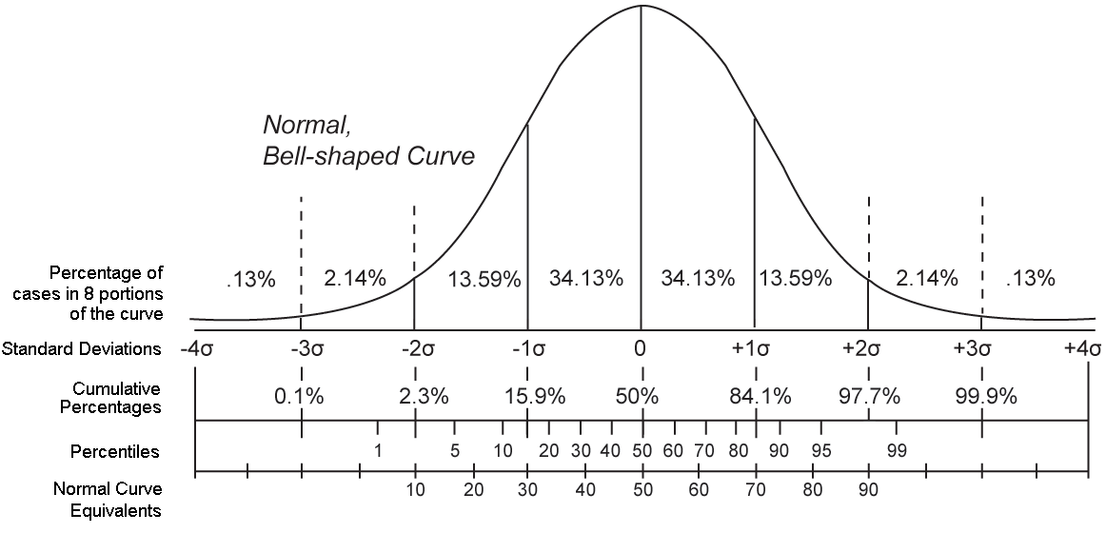
Second derivative method
Based on the concept that there is a type of ‘cut-off’ on a bell-shaped curve where there is a maximum change in slope
  the point above the mean of greatest convexity (≈1.73 SD for a Normal distribution)
Uses numerical differentiation to avoid making assumptions about the underlying distribution
Option in GraphPad Prism™ software, but easily done in Excel
Meletiadis et al., Antimicrob Agents Chemother 2017; 61(4):e02372-16

Slide 43
Second derivative method
Maximum point on graph indicate the dECOFF
Produces a only single ECOFF
Easily applied to data on any scale
Can cope with some left-truncated distributions
Meletiadis et al., Antimicrob Agents Chemother 2017; 61(4):e02372-16

Slide 44
Method comparison
Method | Accessibility | Multimodal performance | Overlap performance* | Caveats
Visual estimation | Anyone can do it | Good | Good | Subjective; can’t be codified
95% rule | Anyone can do it | Poor | Poor | Only works with unimodal data
NRI | Software downloadable | Good ?better | Good | Requires dummy variables; not mid-point adjusted Patented; research purposes only
Iterative statistical | Software downloadable | Good | Good | User chooses ECOFF percentage
Multimodal | Commercial software needed | Good | Good | Can’t cope with unimodal data
Multinomial | Not accessible | Good | ?? | Sophisticated statistical skills and software needed
Second derivative | GraphPad Prism or develop your own | Good | Poor | Single value output; no options Copes with some truncated data
*Selecting ECOFFs when there is significant overlap depends on the desired interpretation

Slide 45
Conclusions 1
MICs are measured on a logarithmic scale and follow a “bell-shaped” distribution in the wild type
The Log-Normal distribution model is suitable for almost all purposes
The observed wild-type distribution is mixture of biological, reagent, reading and test condition variation
The selection of ECOFFs ultimately depends on the intended application; or expressed differently, on whether sensitivity or specificity is prioritised!
There are a variety of methods for estimating ECOFFs
  all are vulnerable to overlap between wild type and non-wild type
  they sometimes agree!

Slide 46
Conclusions 2
There are a variety of methods for estimating ECOFFs
  all are vulnerable to overlap between wild type and non-wild type
  choose one(s) to suit the intended application, considering each of the following criteria:
    accessible
    easy to use
    adjusts to the mid-points of the MIC intervals
    works with both unimodal and multimodal MIC distributions
    works with overlapping distributions, within reason

Slide 47
Conclusions 3
The (reference) MIC assay, as it is currently performed, can be taken to be a ‘robust’ measure of susceptibility, given that it is :
  performed using non-standardized materials (plastics, broth ingredients)
  on very variable species and strains
  under imperfectly-defined conditions (inoculum, temperature, duration)
  read by imperfect humans
Despite its limitations, we have to learn to understand it properly and make the most of it
  and try to avoid truncation when generating distributions

